Slide 1
World Population Data Analysis
by- akash d madhu
class- iv sem bca ‘a’

Slide 2
DATASET OVERVIEW
I have performed an in-depth analysis of the population databy creating the various measures to enhance the insights . Key measures included the number of countries, average population and cumulative population over time.
The analysis was visualised using a combination of charts and slicers in power bi to make the finding interactives and easy to interpret.

Slide 3
DATA CLEANING
Incorrect data types were corrected , and column names were standardized for clarity.
In the age group column , entries listed in months were converted to numerical age values. The population figures for males and females were scaled by multiplying by 1000 and rounded
Unnecessary columns were removed and population data was pivoted

Slide 4
DATA MODELING
After cleaning and transferring the data it was loaded into the model .
Relationship were established between the 3 tables using one-to-many structure
The Fact Population tables served as the fact table
Dim age , Dim region were used as dimension tables

Slide 5
RECOMMENDATIONS
To manage population growth in asia ,strategies should focus on improving access to family planning ,education particularly for women and healthcare to reduse the infant mortality .
To stimulate population growth in Europe policies should include financial incentives for families ,extended paid parental leaves,and affordable childcare and housing.
No immediate action needed for the Oceania , Africa , and North America , as these regions are already experiencing steady population increases

Slide 6
FINDINGS

Slide 7

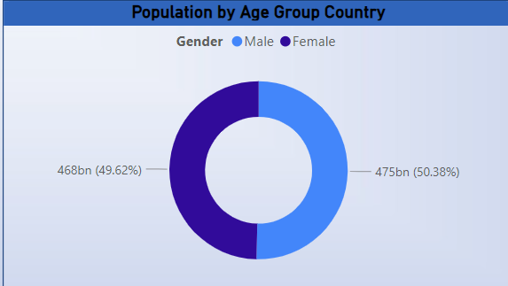
What is the composition of the male and female population worldwide ?
Male and female population were distributed equally

Slide 8
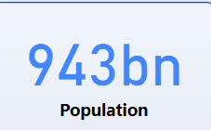
Total population

Slide 9
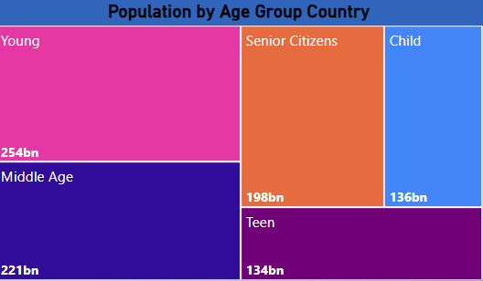
Population by age group country
Largest groups :young and senior citizens
Smaller groups : teen

Slide 10
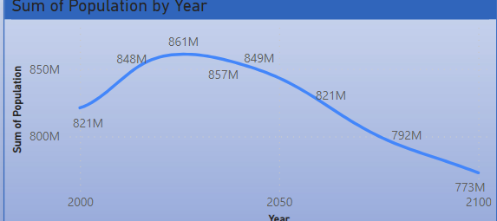
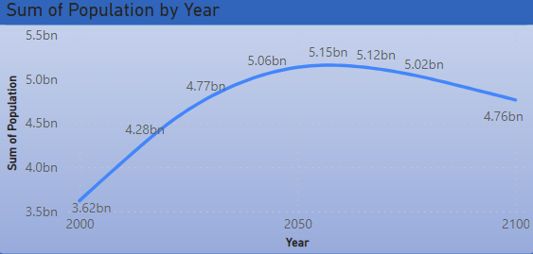
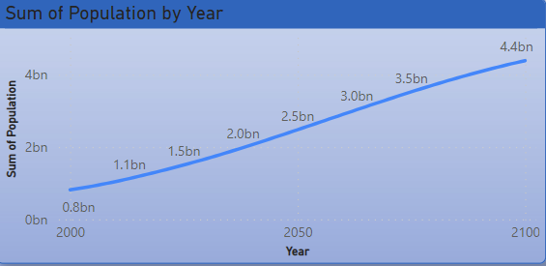
Population trends across the regions over the years
Oceania
Europe
Asia

Slide 11

